Slide 1

An Exhaustive and Extensive Comparison of different methods of Time series Demand forecasting
May 14, 2019
V. Adithya Krishnan
Department of ECE (Avionics)
Indian Institute of Space Science and Technology

Slide 2
Overview
Objective
Literature Survey
What is Demand Forecasting
Demand Forecasting benefits
Steps followed (methodology)
Data Preprocessing and Baseline prediction
Model Implementation
Results and Observations
Conclusion
Bottleneck
Future work

Slide 3
Objective
Finding the forecast for the demand/sales for a given dataset (standard) of a given market using the statistical time series, machine learning regression methods and deep learning techniques.
Comparing the performance of all the models used under a common performance evaluation metric.

Slide 4
Literature survey
“An Empirical Comparison of Machine Learning Models for Time Series Forecasting” – Nesreen K Ahmed and Amir Atiya
“A comparative study of neural network and Box-Jenkins ARIMA modeling in time series prediction” – S L Ho and M Xie
“An Intelligent approach to Demand Forecasting” – Nimai Chand Adhikari and Chinmaya Chandan
“Introduction to time series and forecasting” (book) – P J Brockwell

Slide 5
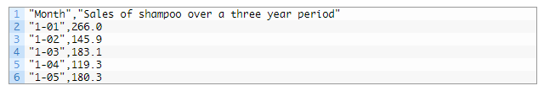
What is Demand Forecasting?
It is a technique for estimation of probable demand for a product or services in the future.
It is based on the analysis of past demand for that product or service in the present market condition.

Slide 6
Demand Forecasting benefits
Predicting the future demand for a product helps the organization in making decisions in one of the following areas:
Planning and scheduling the production and acquiring the inputs accordingly.
Making the provisions for finances.
Formulating a pricing strategy.
Planning advertisement and implementing it and many more.

Slide 7
Steps followed (methodology)
Data Pre-processing and Base-line prediction
Model Fitting and predicting Demand (on test dataset)
Finding out RMSE and comparing models based on it (performance evaluation)

Slide 8
Data Pre-processing and Base-line prediction

Slide 9
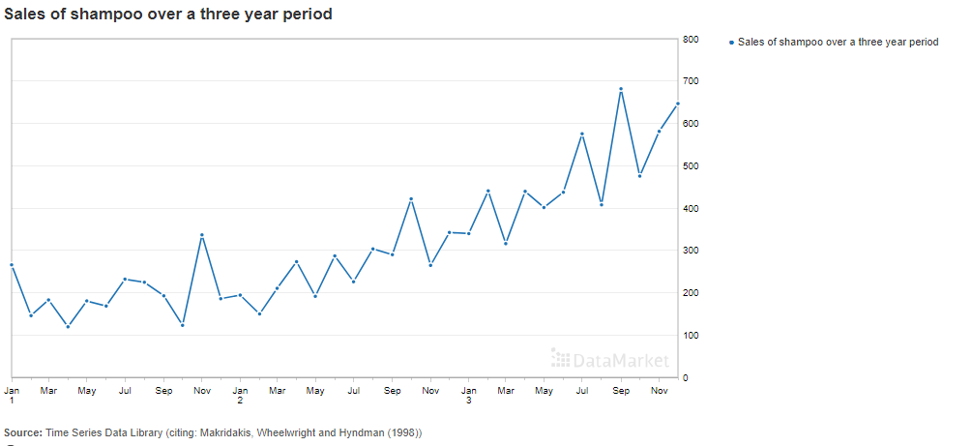
Dataset Used

Slide 10
Dataset Used
A univariate standard dataset is used to implement all our models.
The dataset is called “Shampoo-sales.csv”
It is credited to Makridakis, Wheelwright, and Hyndman
It is the monthly shampoo sales of a company, for a period of three years (1901 – 1903)
But some pre-processing steps are required for fitting Machine Learning and Deep Learning models.

Slide 11
Data Preprocessing
When we use the data on Machine learning and Deep learning models then a few pre-processing steps are required namely:
Transform the time series into a supervised learning problem
Transform the time series data so that it is stationary.
Transform the observations to have a specific scale.

Slide 12
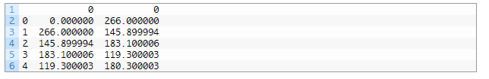
Data Preprocessing (Supervised Learning)
The LSTM model in Keras, and the ML regressors require that your data is divided into input (X) and output (y) components, i.e. a supervised learning problem.
This can be achieved by using the shift() function in Pandas

Slide 13
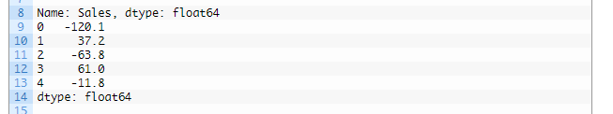
Data Preprocessing (Differencing)
There is an increasing trend in our dataset.
Stationary data is easier to model and will very likely result in more skillful forecasts.
The dataset can be made stationary by differencing, i.e. the observation from the previous time step (t-1) is subtracted from the current observation (t).

Slide 14
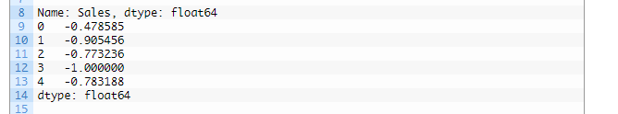
Data Preprocessing (Scaling)
LSTMs expect data to be within the scale of the activation function used by the network and the default activation function for LSTMs is the hyperbolic tangent (tanh), which outputs values between -1 and 1.
Hence our input data should be scaled to be between 1 to -1.
We can transform the dataset to the range [-1, 1] using the MinMaxScaler class.

Slide 15
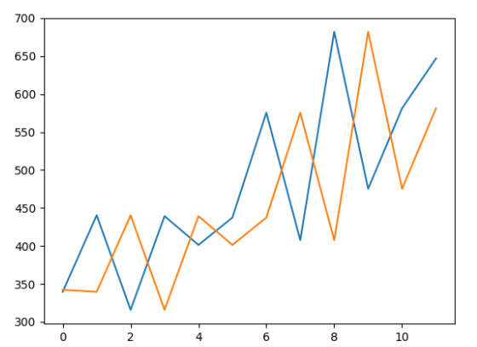
Baseline Prediction
Baseline gives a basis of comparison for models
A good technique for using as baseline should be:-
Simple: Requires little or no training or intelligence.
Fast: Quick to implement and computationally trivial.
Repeatable: Produces an expected/similar output given the same input.
A model performing worse than baseline should be rejected.
Persistance algorithm was used, where the value at the previous time step (t-1) is used as prediction of the expected outcome at the next time step (t).
Baseline Prediction
(Blue-expected
Orange-predicted)
RMSE = 136.71

Slide 16
Model Implementation

Slide 17
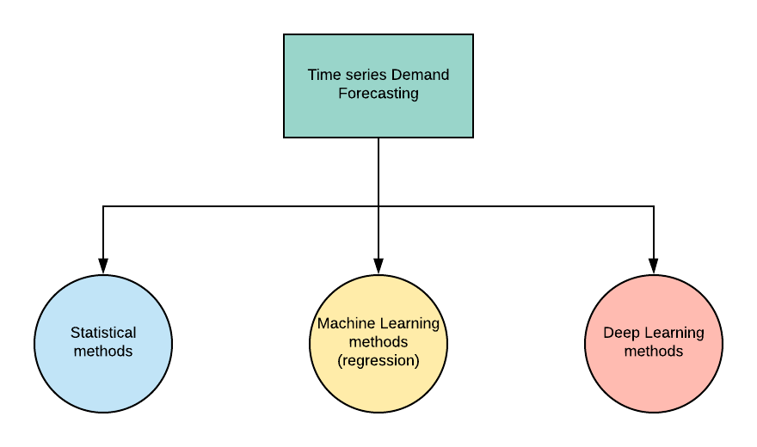
Models Used
Statistical models:-
(AutoRegressive, Moving Average, ARMA, ARIMA, Exponential Smoothing, HoltsWinters)
Machine Learning regressors:-
(Linear – LinearRegression, Lasso, Ridge, ElasticNet, Huber, LassoLars, PassiveAggressive Regressor)
(Non Linear – Kneighbors, DecisionTree, ExtraTree, SVR, AdaBoost, Bagging, RandomForest, GradientBoosting Regressor)
Deep Learning models:-
(LSTM and Multi-Layer Perceptron)

Slide 18
Statistical models:-
An ARIMA model can be created using the statsmodels library as follows:
Define the model by calling ARIMA() and passing in the p, d, and q parameters.
The model is prepared on the training data by calling the fit() function
Predictions can be made by calling the predict() function and specifying the index of the time or times to be predicted.
A value of 0 can be used for a parameter, which indicates to not use that element of the
model. This way, the ARIMA model can be configured to perform the function of an
ARMA model, and even a simple AR, I, or MA model. The parameters p, d and q represent:-
p is the number of autoregressive terms,
d is the number of nonseasonal differences needed for stationarity, and
q is the number of lagged forecast errors in the prediction equation.

Slide 19
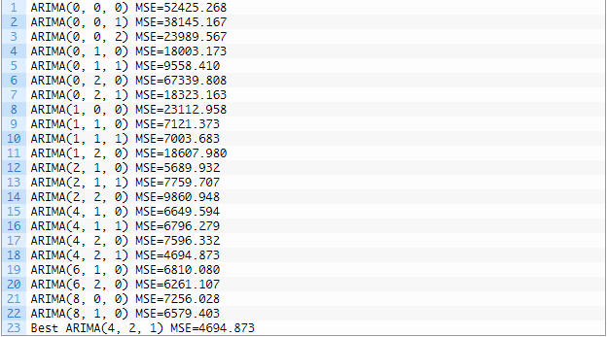
ARIMA hyperparameter optimization
Grid Search HyperParameter optimization: In this process, we fine tune the parameters p, d and q computationally, instead of manually checking for the best fit.
Dataset is split into train and test and then iterated for multiple combination values for pdq and the error in fit (RMSE) is checked(to be min.) by using predicted and expected in order to choose the best parameters.
Similarly the hyperparameters of Exponential smoothing was also optimized.

Slide 20
ML regressor models:-
After the dataset is converted into a supervised learning problem, the traditional linear and non-linear Machine Learning regression algorithms can be applied directly.
Better results are obtained if the dataset is differenced and scaled.
The models were listed in a dictionary (as shown in the fig.) and then called into a fit_model function in order to fit into our dataset.
The linear models where imported from sklearn.linear_model and the non-linear models from sklearn.ensemble, sklearn.tree, sklearn.svm and sklearn.neighbors.

Slide 21
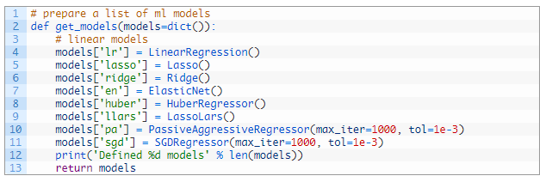
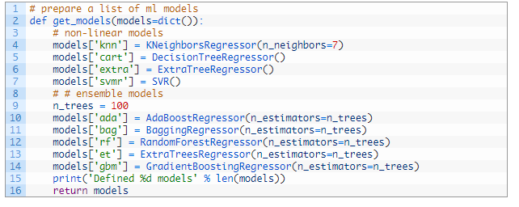

ML regressor models:-

Slide 22
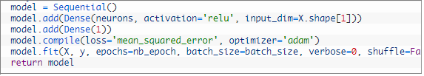
Deep Learning models:-
We structure the Deep learning models using Sequential Keras API to define the network, and then fitting the dataset over it.
Similar to ML models, for a data to be fit on a LSTM or a MLP network, the lag observations must be treated as input features in order to make predictions, i.e. supervised learning problem.

Slide 23
MLP experiments
We’ll run various experiments in order to find optimized hyperparameters.
Each experimental scenario will be run 30 times (in order to account for randomness) and the RMSE score on the test set will be recorded from the end each run and a mean RMSE will be calculated.
The experiments conducted on the MLP network are:-
varying the number of epochs,
varying the number of hidden layer neurons,
varying the hidden layer neurons with lag

Slide 24
LSTM experiments
Similar to the MLP experiments, each experimental scenario will be run 30 times (in order to account for randomness) and the RMSE score on the test set will be recorded from the end each run and a mean RMSE will be calculated.
The experiments conducted on the LSTM network are:-
varying the number of epochs,
varying the number of hidden layer neurons,
varying the batch size

Slide 25
Results and Observations

Slide 26
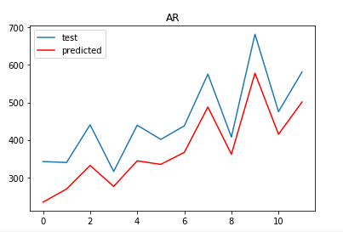
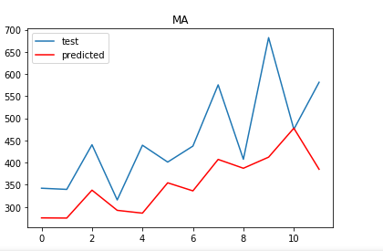
Results (Statistical models)
AutoRegressive model
Moving average model
RMSE: 81.297
RMSE: 127.633

Slide 27
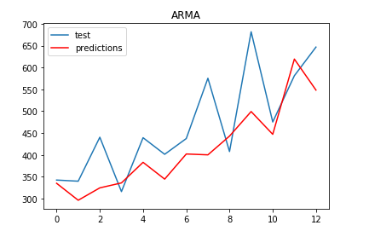
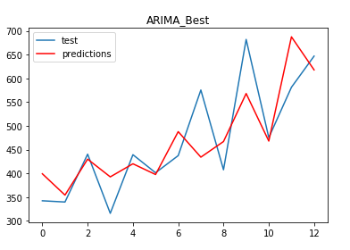
Results
ARMA model
ARIMA model (hyperparameter opt.)
RMSE: 88.089
RMSE: 68.519

Slide 28
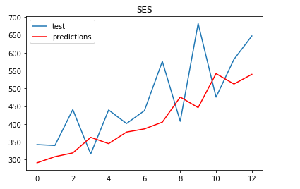
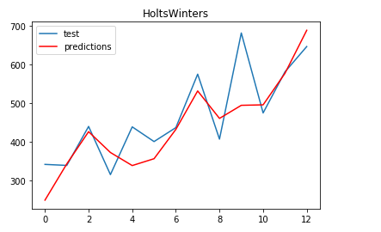
Results
Simple Exponential
HoltsWinter Exponential
RMSE: 104.762
RMSE: 71.212

Slide 29
Results
Model | RMSE
AutoRegression | 81.297
Moving Average | 127.633
ARMA | 88.089
ARIMA (Best) | 68.519
Simple Exponential | 104.762
HoltsWinter (Best) | 71.212

Slide 30
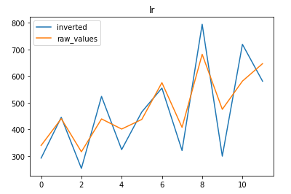
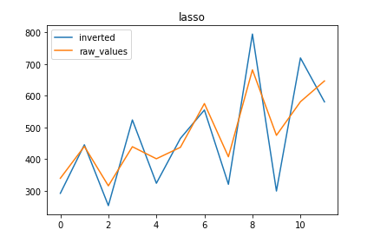
Results (Linear ML models)
LinearRegression model
Lasso model
RMSE: 89.038
RMSE: 89.021

Slide 31
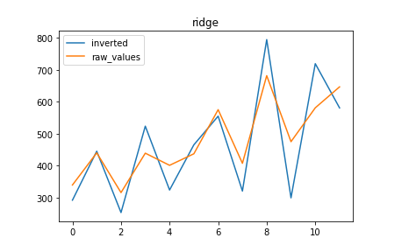
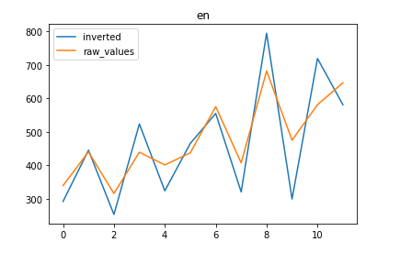
Results
Ridge model
ElasticNet model
RMSE: 89.038
RMSE: 89.024

Slide 32
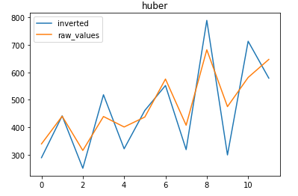
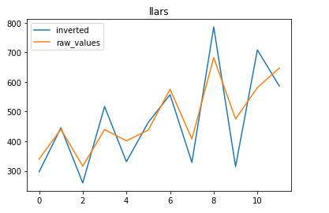
Results
Huber model
LassoLars model
RMSE: 87.776
RMSE: 81.591

Slide 33
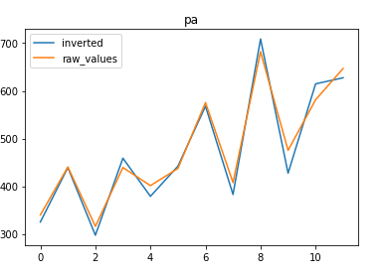
Results
PassiveAgressive model
RMSE: 23.555

Slide 34
Results
Model | RMSE
LinearRegresssion | 89.038
Lasso | 89.021
Ridge | 89.038
ElasticNet | 89.024
Huber | 87.776
LassoLars | 81.591
PassiveAgressive | 23.555

Slide 35
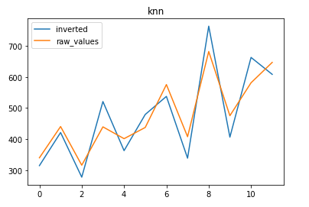
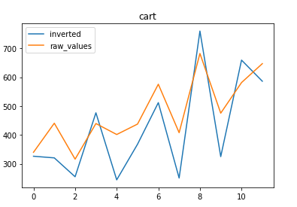
Results (Non Linear ML models)
Kneighbors model
DecisionTree model
RMSE: 56.397
RMSE: 98.548

Slide 36
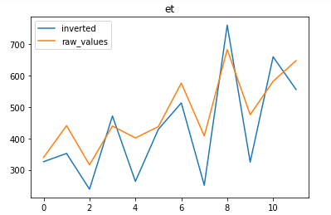
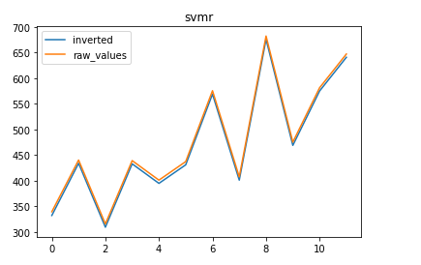
Results
ExtraTree model
SVR model
RMSE: 109.479
RMSE: 6.416

Slide 37
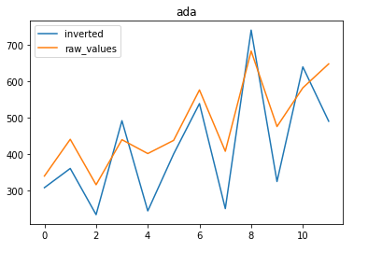
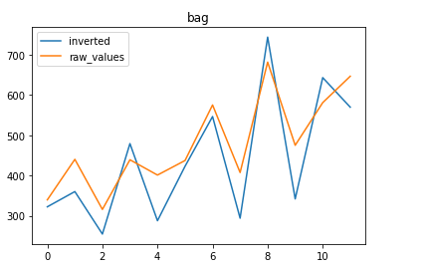
Results
AdaBoost model
Bagging model
RMSE: 101.204
RMSE: 76.525

Slide 38
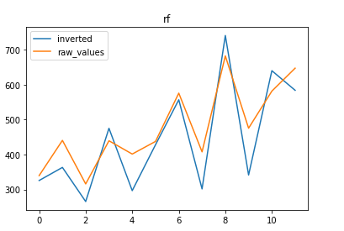
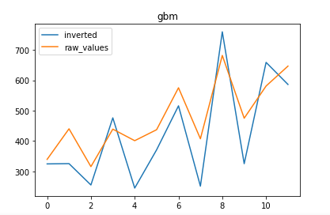
Results
RandomForest model
GradientBoosting model
RMSE: 71.502
RMSE: 97.140

Slide 39
Results
Model | RMSE
KNeighbors | 56.397
DecisionTree | 98.548
ExtraTree | 109.479
SVR | 6.416
AdaBoost | 101.204
Bagging | 76.525
RandomForest | 71.502
GradientBoosting | 97.140

Slide 40
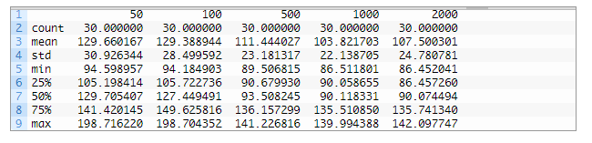
Results (Deep Learning models)
MLPs with tuning epochs
The exp. is run 30 times and the mean RMSE and other stats are given here. (to cover the randomness)
The MLP is trained with varying epochs (50,100,500….)

Slide 41
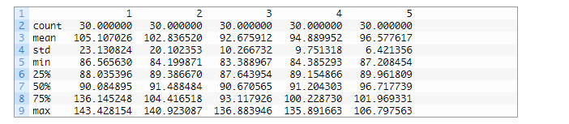
Results
MLPs with tuning hidden neurons
The MLP is trained with varying hidden layer neurons (1, 2, 3, ….)

Slide 42
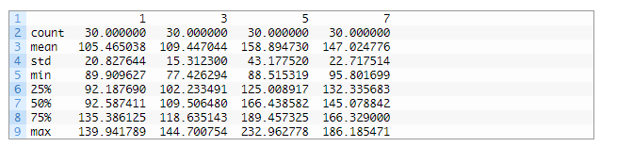
Results
MLPs with tuning hidden layer lags
The MLP is trained with varying hidden layer lags (1, 3, 5, ….)

Slide 43
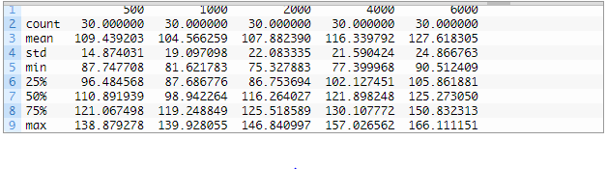
Results
LSTMs with tuning epochs
The exp. is run 30 times and the mean RMSE and other stats are given here. (to cover the randomness)
The Lstm is trained with varying epochs (500,1000,2000….)

Slide 44
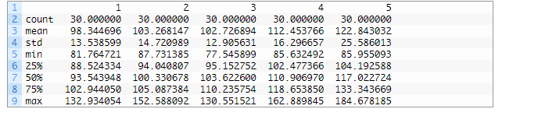
Results
LSTMs with tuning neurons
The Lstm is trained with varying neurons
(1, 2, 3, ….)

Slide 45
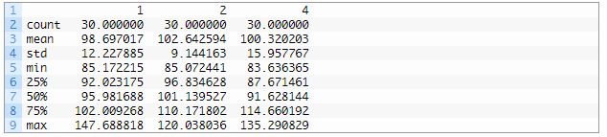
Results
LSTMs with tuning batch size
The Lstm is trained with varying batchsize
(1, 2, 3, ….)

Slide 46
Results
We see here that after tuning the hyperparameters of the LSTM, the best RMSE comes out to be for one hidden neuron, batchsize of 4 and 1000 epochs, which is, RMSE = 98.697
We see that after tuning the epochs, neurons and lags the best RMSE Score for MLP is for 1000 epochs, 3 neurons and a lag of one, which is, RMSE = 92.675.

Slide 47
Results
Model | RMSE
MLP(1 nueron) – 100 epochs | 129.388
MLP (1 neuron) – 1000 epochs | 103.821
MLP (3 neurons) – 1000 epochs | 92.675(best)
LSTM (Batchsize 4) – 500 epochs | 109.432
LSTM (Batchsize 4) – 1000 epochs | 104.566
LSTM (Batchsize 1) – 1000 epochs | 98.697(best)
LSTM (Batchsize 4) – 1000 epochs – 3 neurons | 102.726
One
neuron

Slide 48
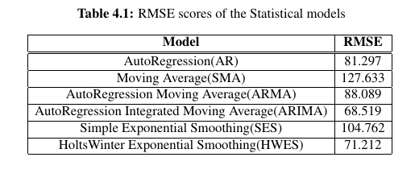
Conclusion
Among all the statistical models, ARIMA performed the best, followed by HoltsWinter.
This is due to the extra parameters to be optimized.(p,d,q)

Slide 49
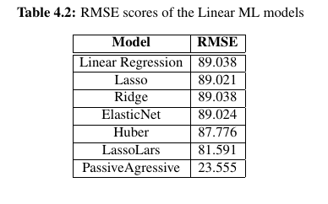
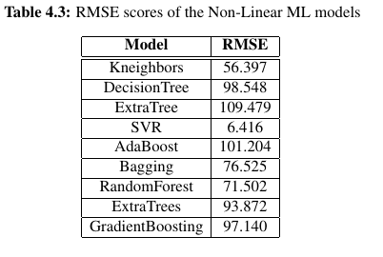
Conclusion
ML regressors perform on par with the best statistical methods, sometimes even outperform

Slide 50
Inferences
ARIMA performs the best amongst the statistical models.
Linear ML regressors perform almost the same.
Passive Aggressive and SVR out perform the other models, and they are very similar in nature.
Ensemble methods perform better than their counterpart.
Deep learning algorithms perform on par with other models.

Slide 51

Bottlenecks
To judge the behaviour of the models properly we need to fit our models on more datasets, which should be more complex and multivariate.
Other performance metrics can capture more details while comparing models, and that should also be tested.
In depth analysis of each model needs to be carried out for better understanding

Slide 52
Future Work
More in depth analysis of the models, and their functioning can be made.
The comparison analysis can be done on minimum 3 datasets of varying complexity.
Other performance metrics can be explored.
More models in Deep learning (like GRUs, CNNs), Statistical (like xgBoost) and ML regressors (like LightGBM) can also be implemented.

Slide 53
Future Work (on going)
Designing an Ensemble method using weighted predictions from all of our Statistical, ML and Deep learning models.
Creating an algorithm for deciding the weights based on our dataset.
Getting atleast a 5 - 10% increase in forecast accuracy when compared to all the models.
Creating a product which can be released in the market.

Slide 54
References
[1] N. C. D. Adhikari, N. Domakonda, and C. Chandan, “An intelligent approach to de-
mand forecasting,” International Conference on Computer Networks and Communica-
tion Technologies, 2019
[2] P. J. Brockwell, R. A. Davis, and M. V. Calder, Introduction to time series and fore-
casting. Springer, 2002, vol. 2.
[3] G. P. Zhang, “Time series forecasting using a hybrid arima and neural network model,” Neurocomputing, vol. 50, pp. 159–175, 2003.
[4] K.-j. Kim, “Financial time series forecasting using support vector machines,” Neuro-
computing, vol. 55, no. 1-2, pp. 307–319, 2003.
[5] A. Pankratz, Forecasting with univariate Box-Jenkins models: Concepts and cases.
John Wiley & Sons, 2009, vol. 224.

Slide 55
References
[6] N. K. Ahmed, A. F. Atiya, N. E. Gayar, and H. El-Shishiny, “An empirical comparison
of machine learning models for time series forecasting,” Econometric Reviews, vol. 29,
no. 5-6, pp. 594–621, 2010.
[7] S. Ho, M. Xie, and T. Goh, “A comparative study of neural network and box-
jenkins arima modeling in time series prediction,” Computers & Industrial Engineer-
ing, vol. 42, no. 2-4, pp. 371–375, 2002.
[8] Z. Tang, C. De Almeida, and P. A. Fishwick, “Time series forecasting using neural
networks vs. box-jenkins methodology,” Simulation, vol. 57, no. 5, pp. 303–310, 1991.

Slide 56
Thank You

